Slide 1
Chapter 28: The Lost Generation and a New Post-War Culture
By Audrey Pham

Slide 2
Click on any of the titles to be directed to that slide, or anywhere on this slide to move forward.
Psychology
Sigmund Freud
Humanities
Popular Literature
The Lost Generation
Effects of Freud
Science
Artistic Movements
Philosophy
The Nature of Matter
Quantum Physics
Biological and Social Science
Public Culture
Popular Trends

Slide 3
Psychology: Sigmund Freud
Sigmund Freud (1856-1939) was a Viennese physician most famous for his tendency to relate all psychological problems to sexual issues.
He claimed that the most “decent” people were simply the most repressed.
Found and labeled the parts of the unconscious: the id, where universal basic desires seek satisfaction; the ego, which tries to channel and control these desires; and the superego, which directs these desires, much like a conscience, and imposes a socially conditioned sense of what is acceptable.
Mental life is marked by tension between the ego and the superego.
Because this conflict takes place in the unconscious, most people remain unaware of their deepest desires.
Freud named his body of theory and therapeutic technique psychoanalysis.
Called on the analyst to not pass judgments, but to help the patient discover aspects of self on his own.
Considered whatever seemed real to the psyche to be important; valued treatment methods such as hypnosis and free association.
Freud’s innovations included talk therapy and the therapy couch, the image most associated with psychology today.

Slide 4
Wider Implications of Freudian Psychology
In the 1920s, Freud’s discoveries gained wider recognition.
The most popular notion derived from Freudian teaching was that since repression led to neuroses, greater sexual freedom and candor would produce healthier people.
Freud did not hold this belief himself.
Freudian insights encouraged literary and personal introspection and supported the view that childhood is the most important phase of life.
Freud held that civilization was based on the repression of primitive drives, which could explode at any moment.
“The price of progress in civilization is paid in forfeiting happiness.”
The concepts and vocabulary of psychoanalysts penetrated much of Western culture, including art, literature, journalism, and advertising.
The Surrealists applied Freudian ideas to art.
André Breton, a writer, proclaimed that art must liberate the subconscious.
Click to browse an online gallery of contemporary Surrealist art.

Slide 5
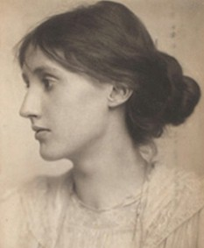
Literature
Marcel Proust (1871-1922)
Hailed as one of the great stylists of the French language.
Remembrance of Things Past: introverted, detailed picture of upper-class Parisian life and one man’s quiet suffering; became the model for interior monologue.
Franz Kafka (1883-1924)
Manuscripts included realistic, reasonable description of fantasies that convey the torture of anxiety.
The Trial (1925): an exploration of the psychology of guilt; foreshadows totalitarian state.
James Joyce (1882-1941)
Ulysses (1922): the life of a modest Dubliner; exuberant, inventive language using puns, cliché, parody, and poetry.
Virginia Woolf (1882-1941)
Political activist, feminist prominent in England’s intellectual circles
A Room of One’s Own (1929): explored value of female perspective, ways in which women were repressed from intellectual independence.
Virginia Woolf

Slide 6
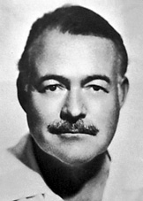
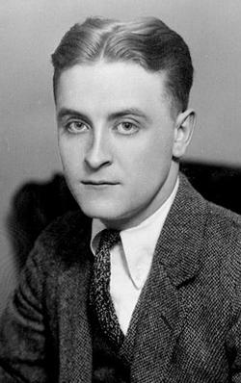
The Lost Generation
Term popularized by Ernest Hemingway, who used it in his an epigraph in his novel The Sun Also Rises
Gertrude Stein, Hemingway’s mentor, used the term to describe the people of the 1920s who rejected American post-World War I values
Also used to describe the generation of writers active immediately after World War I; their sense of moral loss or aimlessness
Ernest Hemingway, F. Scott Fitzgerald, and John Dos Passos
Criticized American culture in creative fictional stories that had themes of self-exile, indulgence, and spiritual alienation
Fitzgerald's This Side of Paradise shows the young generation of the 1920s masking their depression behind the forced exuberance of the Jazz Age
Novels produced by the Lost Generation give insights into lifestyles during the 1920s.
Ernest Hemingway
F. Scott Fitzgerald

Slide 7
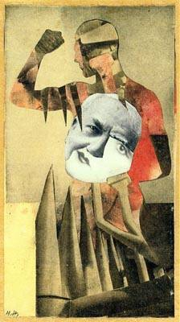
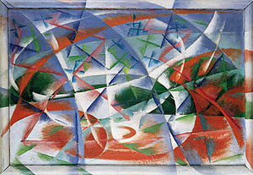
The Other Arts
Works of art became more difficult to comprehend. To contemporaries, they were threatening and violent.
Dada
Originated during World War I
Put on displays that were half theater, half art exhibition, full of noise and absurd juxtaposition intended to infuriate the Parisian bourgeoisie.
Created the photomontage as a way to combine various types of art, and express the madness of the age.
Futurism in Italy
Movement led by poets, playwrights, and artists
Promised to build a new art for a technological age
Strong-Armed Men
Hannah Höch
Abstract Speed + Sound
Giacomo Balla

Slide 8
Philosophy
Oswald Spencer
Decline of the West (1918): most widely read philosophical work in the 1920s; treated whole civilizations as biological organisms, each with lifecycles of its own.
José Ortega y Gasset
The Revolt of the Masses (1930): warned that the masses were destined to use their rising power to destroy civilization’s highest achievements.
Bertrand Russell and Alfred North Whitehead
Principia Mathematica (1910): became the cornerstone of analytic philosophy, which held that philosophers should concern themselves only with what is precise and empirically demonstrable.
The Vienna Circle on the Continent developed related system: logical positivism.
Ludwig Wittgenstein
Tractatus Logico-Philosophicus (1921): the philosopher’s duty was the analyze every statement and strip away whatever did not convey precise meaning.
Influenced both analytic philosophy and logical positivism.

Slide 9
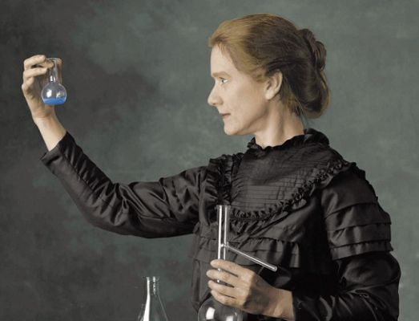
The Nature of Matter
Albert A. Michelson and Edward W. Morley
Demonstrated that the speed of light was the same regardless of whether it traveled in the same direction as the earth
Challenged the existence of “ether,” the motionless substance supposed to fill the universe
Led Albert A. Einstein to theory of relativity
Space and time must be measured in relation to the observer and are aspects of a single continuum.
Wilhelm Roentgen
Discovered x-rays in 1895; gave insight into world of subatomic particles
J.J. Thompson
Showed existence of electron
Pierre and Marie Curie
Discovered radioactive material
Ernest Rutherford
Identified radioactivity with breakdown of heavy and unstable atoms
Marie Curie

Slide 10
Quantum Physics
Scientists made discoveries that challenged Newtonian physics
Max Planck
Energy in the subatomic world was released or absorbed in discrete, measurable irreducible units (called quanta) rather than in a continuous stream.
Einstein incorporated this into his equation E = m$c^{2}.$
In theory, small quantities of matter could be turned into large amounts of energy; proved Newtonian physics wrong in that matter could be transformed into energy.
Werner Heisenberg
Uncertainty Principle: the impossibility of measuring a particle’s position and momentum due to measurements at the subatomic level interfering with the variables being measured.

Slide 11
The Biological and Social Sciences
Knowledge of mechanisms of heredity furthered scientific breeding of animals and plant hybridization, increasing productivity of agriculture
Sir Alexander Fleming and Sir Howard Florey
Discovered penicillin in 1928
Émile Durkheim and Max Weber
Durkheim used statistical tools, Weber used the “ideal type” to analyze how societies function
Emphasized importance of religion in regards to how it contributed to development of the state
Stressed threat to society of group norms breaking down

Slide 12
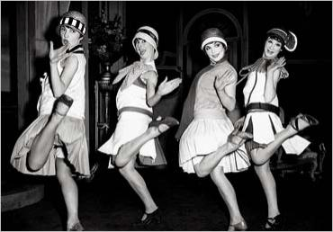
Public Culture
Hoagy Carmichael and Mitchell Parish’s “Stardust”
Cinema
Became more popular and profitable than any form of entertainment in history
People of every class attended; women could go without male escorts
The USA led in film production, followed by Japan and Germany
Introduction of talking pictures underscored national differences; countries strained to censor on-screen sex and violence
Many countries banned German films in the 1920s
Music
In America, the period after World War I and before the start of the Great Depression was known as the “Jazz Age”
Jazz openly learned from African art
Consumerism
Sophistication was used to justify lipstick, short skirts, alcohol
Berlin rivaled Paris as a European artistic center for the first time
The “flapper dress,” popularized in the ‘20s.

Slide 13
Works Cited
"1920s - 1930s Lost Generation." PBS. PBS, n.d. Web. 05 Mar. 2013.
Balla, Giacomo. Abstract Speed + Sound. 1913. Guggenheim, New York. N.p.: n.p., n.d. N. pag. Guggenheim Collection Online. Web. 5 Mar. 2013.
Chambers, Mortimer. The Western Experience. Boston: McGraw-Hill, 2007. Print.
"Ernest Hemingway - Biography". Nobelprize.org. 5 Mar 2013
"F. Scott Fitzgerald." Findagrave.com. Find A Grave, n.d. Web.
Höch, Hannah. Strong-Armed Men. 1931. Cut And Paste. Web. 05 Mar. 2013.
"The Lost Generation: AMERICAN WRITERS OF THE 1920'S." Mongomerycollege.edu. Montgomery College, n.d. Web. 05 Mar. 2013.
"Sigmund Freud." 2013. The Biography Channel website. Mar 05 2013, 12:36
"Sigmund Freud." NNDB. Soylent Communications, n.d. Web. 05 Mar. 2013.
Theo. "A Look at The Roaring Twenties: Fashion, Slang and Culture." The Vampire Diaries. Alloy Entertainment, n.d. Web. 05 Mar. 2013.

